Slide 1
Lisa’s Status Updates Semester 2

Slide 2
Agenda
Weekly Goal?
Status?
Demo:
Github Page
Monday Project Board
Project Plan – Technical Document

Slide 3
Lisa’s Status Updates Semester 3 Backend Web Developer

Slide 4
Agenda – Semester 3, Week 1
Week 1 Activities: GitHub Branching, Difficult Conversations, Coding Practice – Implemented a “Stack”
Status? Behind. Resolution Plan: Put in additional time after class today to push additional work, and may have to reschedule to next week.
Demo:
Project Work: “Project Pulse” – Application to manage projects, clients, & team work
Monday Project Board
Notes:
To implement a stack is to create a working data structure that adheres to the Last-In, First-Out (LIFO) principle.

Slide 5
Setting up the Backend
install Express: This installs Express.js, the most popular web framework for Node.js. It provides a robust set of features to build web applications and APIs, handling everything from routing to middleware.
install Sequelize: This installs Sequelize, a Node.js Object-Relational Mapper (ORM). An ORM helps you interact with a database by mapping database tables to JavaScript objects, allowing you to perform database queries and manipulations with code instead of writing raw SQL.
install SQLite: This installs the SQLite library, a driver that allows Sequelize to connect to an SQLite database. SQLite is a simple, file-based database, which is ideal for development and prototyping because it doesn't require a separate server process.
Notes:
Express: The main frame for your lemonade stand.
Sequelize: The helpful translator who knows the language of the recipe box.
SQLite: The simple recipe box itself.

Slide 6
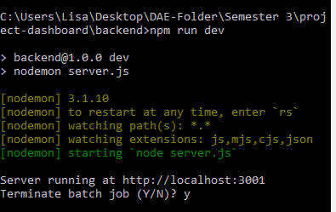
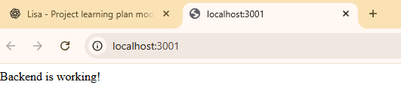
Setting up the Backend

Slide 7
Lisa’s Status Updates Semester 3 Backend Web Developer

Slide 8
Agenda – Semester 3, Week 2
Week 2 Activities: ADR (Architectural Design Review), Contributing.md file, RCA (Root Cause Analysis) file
Project Work “Project Pulse” & Schoology SQL 1 & 2
Status? Behind. Resolution Plan: Reschedule and adapt for next week.
Demo:
ADR, contributing.md, root-cause-analysis file, SQL 2 deliverables
Monday Project Board
Notes:
ADR
Architectual Design Review document
A report where you document big decisions and why you made those decisions
For example
Constructing a new building
Decided to use solar panels for power
ADR would document this "choice" , list pros & cons & why you chose this
Why important? helps makes sure everyone involved know whats going, on the same page, and if someone new joins the team, helps them catch up on whats been decided and why
prevents confusion
Contributing.md
school project
working to build a new application together
contributing md tells everyone on the team how to contribute
example: need to submit your code using a specific method
need to follow certain formatting rules
make sure to test you feature before submitting
why important? sets clear expectations
helps people joining the project know how to contribute
prevents messiness i.e., different coding styles and fixing things to match up
root cause analysis file
report you write after you've encountered a problem & figured it out,
so that you can document what happened, why it happened, how it was resolved
so that it doesnt happen again
example: school website it down
why? servers overloaded
why? too many students logged in at the same time
why? exam review sheet was posted only 30 minutes before servers crashed
Issue: timing of the document release, not technical issue
Solution: New policy Post exam review sheets 24 hours in advance
SQL is a computer language used to ask questions and get information from a database, and to add, change, and remove information
student database at school with grades
SQL to quickly find students with passing grade, or add records for new students
insert, update, delete, create
why important? lets you organize and analyze data efficiently, handy when working with large amounts of data

Slide 9
Lisa’s Status Updates Semester 3 Backend Web Developer

Slide 10
Agenda – Semester 3, Week 3
Week 3 Activities: GitHub status badge, Interview for coding practice “Sort a list”
Project Work: “Project Pulse” & Schoology SQL 1 & 2
Status? Behind.
Resolution Plan: Wrap up project, and pivot to planning next Semester’s job related learning goals.
Demo

Slide 11
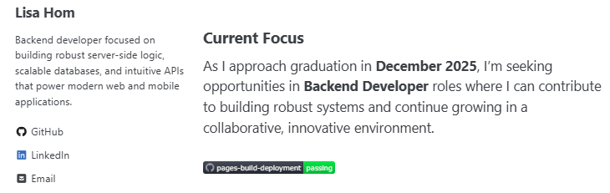
GitHub Status Badge

Slide 12
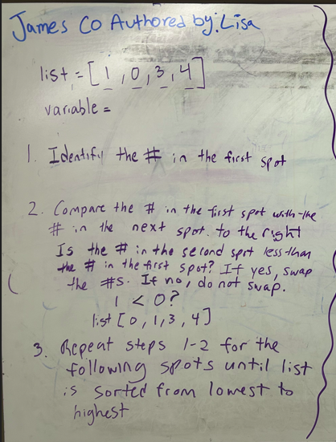
Coding Practice: Sort a List

Slide 13
Lisa’s Semester 3 Presentation Backend Web Developer

Slide 14
Agenda – Semester 3, Presentation
Week 4 Activities: README.md file, Implement a Stack
Schoology SQL 1 & 2
Project Work: “Project Pulse”
Status? Complete
Demo

Slide 15
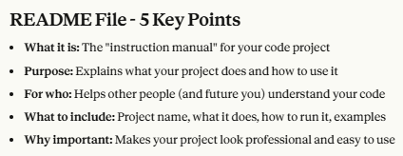
README.md

Slide 16
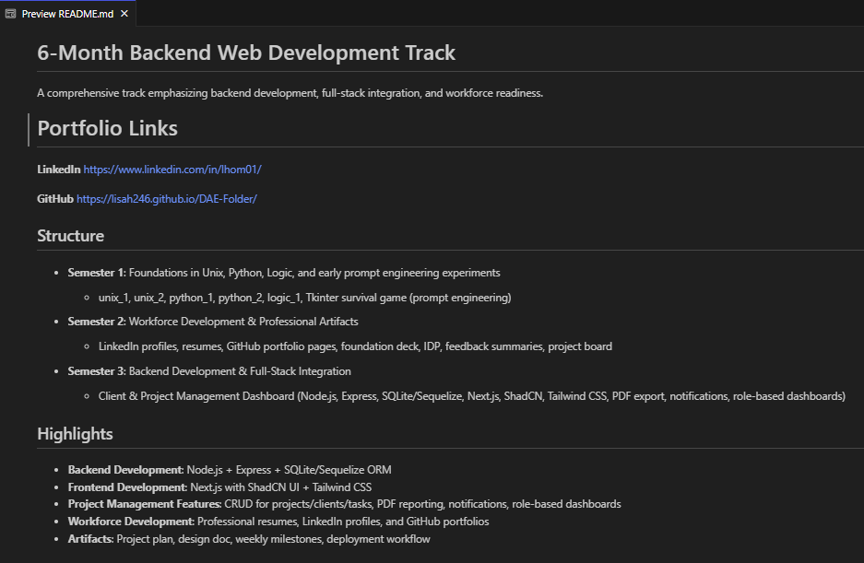
README.md

Slide 17
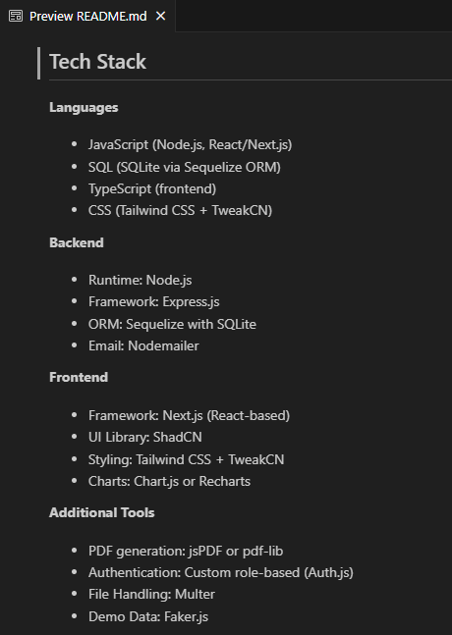
README.md

Slide 18

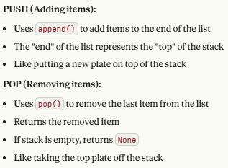
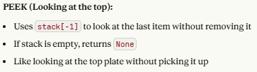

STACK

Slide 19
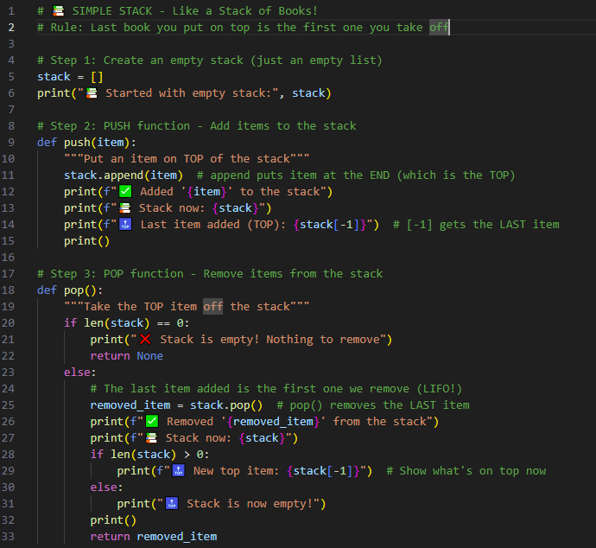
STACK

Slide 20
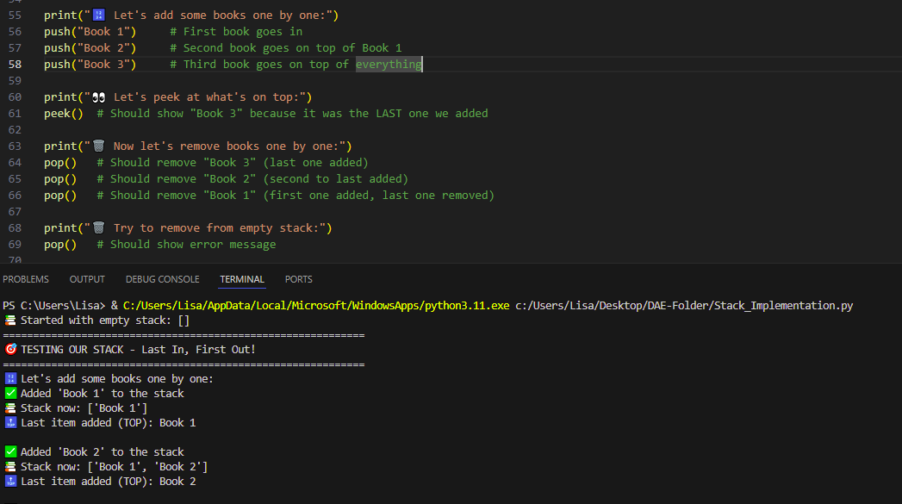
STACK

Slide 21
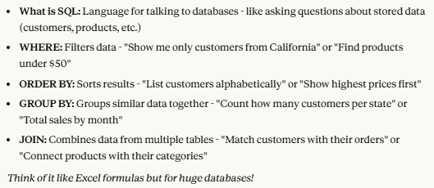
Schoology: SQL 1 & 2

Slide 22
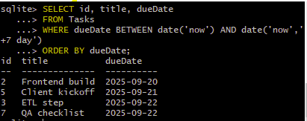
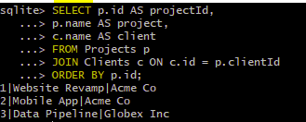
Project Pulse – Backend

Slide 23
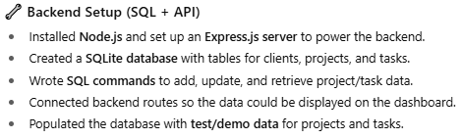
Project Pulse – Backend

Slide 24

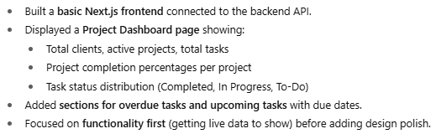
Project Pulse – Frontend

Slide 25
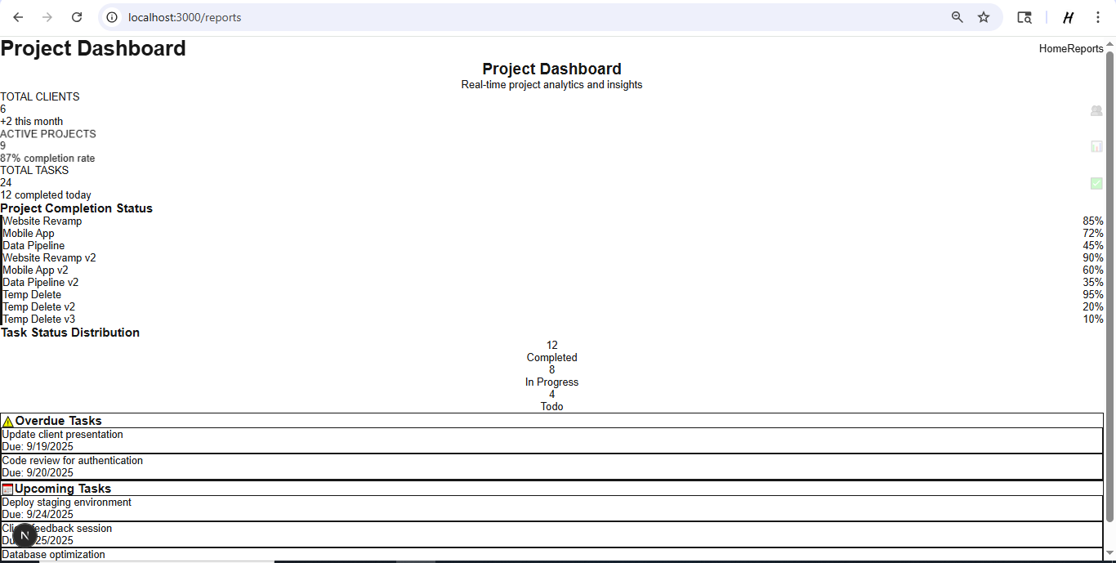
Project Pulse – Frontend

Slide 26
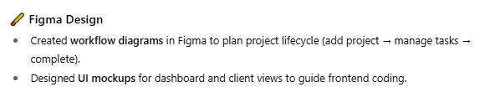
Project Pulse – Figma

Slide 27
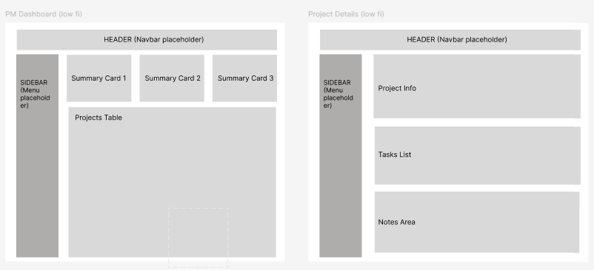
Project Pulse – Figma

Slide 28
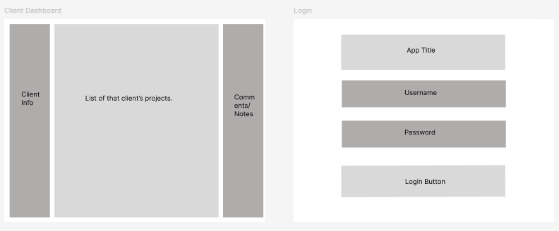
Project Pulse – Figma

Slide 29
Thank You!

